Slide 1

Research Methodology
Scientific Article Writing & Abstract
Dr. Arti Arya
Department of Computer Science and Engineering

Slide 2

Research Methodology
Scientific Article Writing & Abstract
Dr. Arti Arya
Department of Computer Science and Engineering

Slide 3

Research Methodology
Overview- Scientific Article Writing
Definition of a scientific paper
The IMRAD format (IMRaD)
Front matter: title, author(s), abstract
Core of the paper: introduction, methods, results, discussion
Tables and figures
End matter: acknowledgments, references
A suggestion
Sources of further guidance

Slide 4

Research Methodology
Scientific Paper - Definition
The first publication of original research results
In a form whereby peers of the author can repeat the experiments and test the conclusions
In a journal or other source document readily available in the scientific community

Slide 5
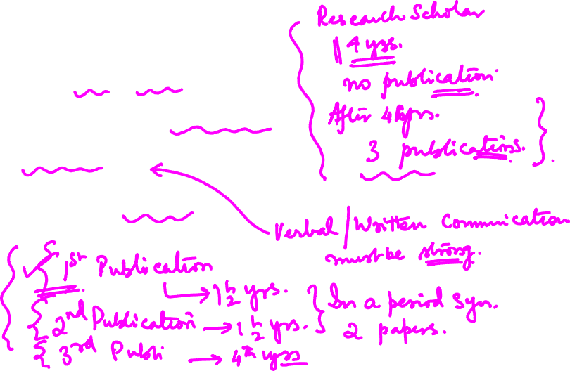
Research Methodology
Scientific Paper - Significance
From the Author’s Perspective
• Let others know your research finding.
• Effective communication is very important..
• Typically it’s the last step.

Slide 6
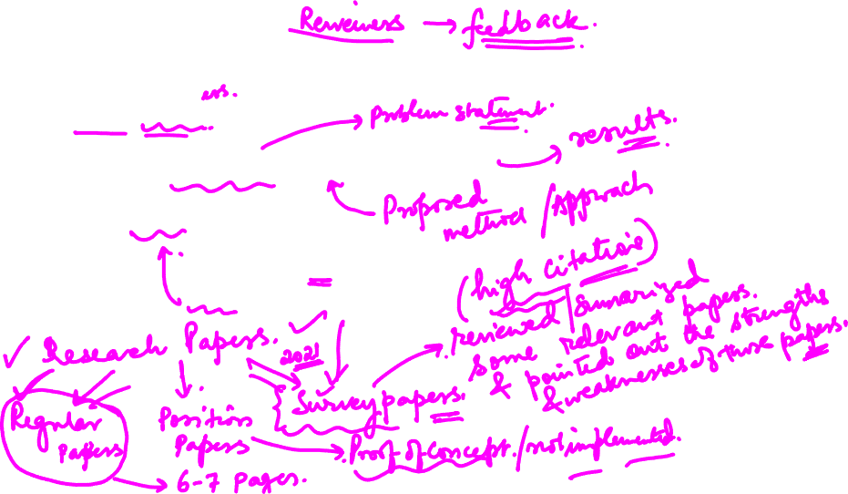
Research Methodology
Scientific Paper - Significance
From Reader/Reviews perspective
• Read about the project’s aims, methods and findings
• Assess the quality of the project
• Provide feedback to the project’s researchers on what they like or dislike about the project
• Incorporate aspects of the project’s methods or findings into their own work or thinking.
• Summarized as 4 A’s (Aim, Awareness, Audience, Articulation)

Slide 7
Research Methodology
Scientific Paper - Significance
From Reader/Reviews perspective
• Read about the project’s aims, methods and findings
• Assess the quality of the project
• Provide feedback to the project’s researchers on what they like or dislike about the project
• Incorporate aspects of the project’s methods or findings into their own work or thinking.
• Summarized as 4 A’s (Aim, Awareness, Audience, Articulation)

Slide 8
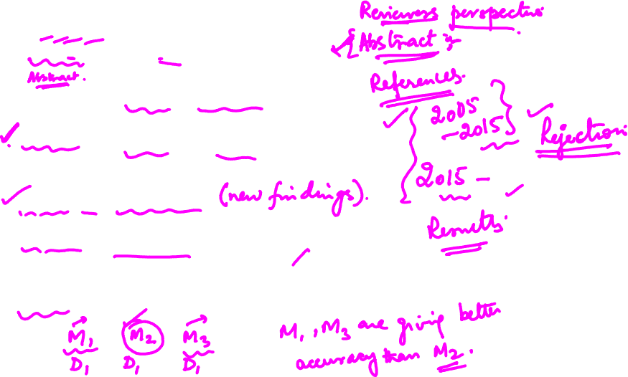
Research Methodology
The IMRAD Format for Scientific Papers
Introduction: What was the question?
Methods: How did you try to answer it? (Materials and Methods)
Results: What did you find?
Discussion: What does it mean?
A format used in some journals: IRDaM
People read sections in various orders.

Slide 9

Research Methodology
The IMRAD Format for Scientific Papers
The Front Matter
Title
Authors
Abstract

Slide 10

Research Methodology
The IMRAD Format for Scientific Papers
Title
The fewest possible words that adequately indicate the contents of the paper
Important in literature searching
Should not include extra words, such as “a study of”
Should be specific enough but not overly narrow

Slide 11

Research Methodology
Good Research Title
Why is it important?
First thing noticed by Readers & Reviewers.
Available in abstracting and indexing databases
Its indexed by search engine and seen in queries.
Make sure that Research Title
Captures all of the relevant aspects of your study,
Shows in a way that is accessible and captivating to readers.

Slide 12

Research Methodology
Good Research Title
Challenge? – To create a title that is
Specific, Crisp, Clear, Concise (Neither too short or too long)
Expressive.
No undue expectations.
Choose words that are used for indexing purposes
Avoid waste words like “Studies on”, “Investigation on” etc.
Avoid Opening Words like “A/An/The”

Slide 13

Research Methodology
Good Research Title: How?
Basic questions about the research paper.
What, Method used, Subjects, Results
Identify Keywords/phrases from the above questions
Create a “long” sentence with these keywords
Create a working title, Eliminate extra words/phrases

Slide 14
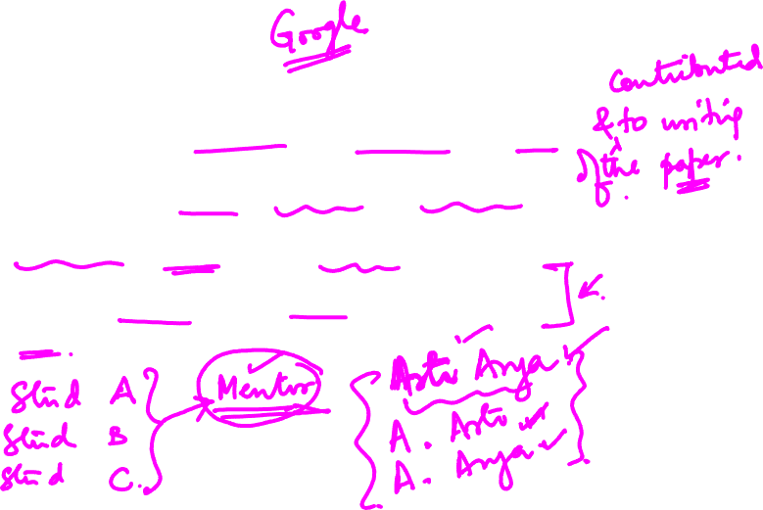
Research Methodology
Authors
Those with important intellectual contributions to the work
Often listed largely from greatest contributions to least
Head of research group often is listed last
Important to list one’s name the same way from paper to paper

Slide 15
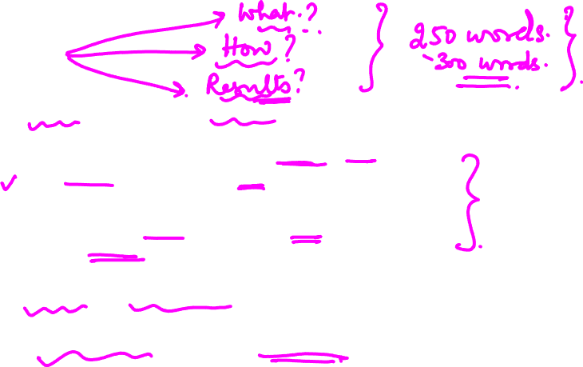
Research Methodology
Abstract
Summarizes the paper (miniature version of the paper)
A well-prepared abstract enables readers to identify
the basic content of a document quickly and accurately, to determine its relevance to their interests,
and thus to decide whether they need to read the document in its entirety
Widely read and therefore important
Returned by search engines (based on search query)

Slide 16
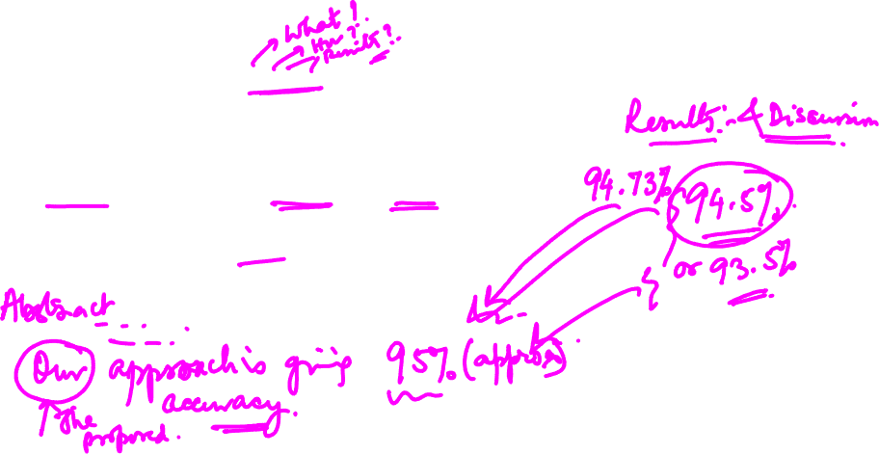
Research Methodology
Abstract
Commonly organized in IMRAD format (may be structured abstract, with headings corresponding to the various sections)
Content must be consistent with that in the paper
Normally should not include figures, tables, references

Slide 17
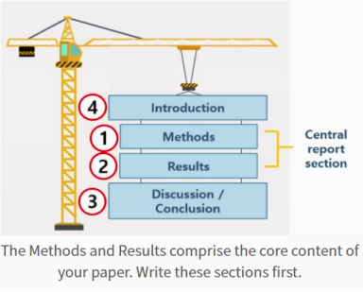
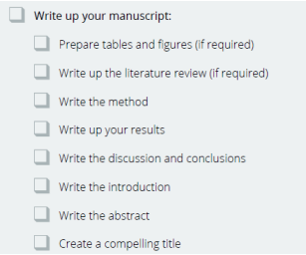

Research Methodology
The Core of the Paper
Introduction
Methods
Results
Discussion

Slide 18

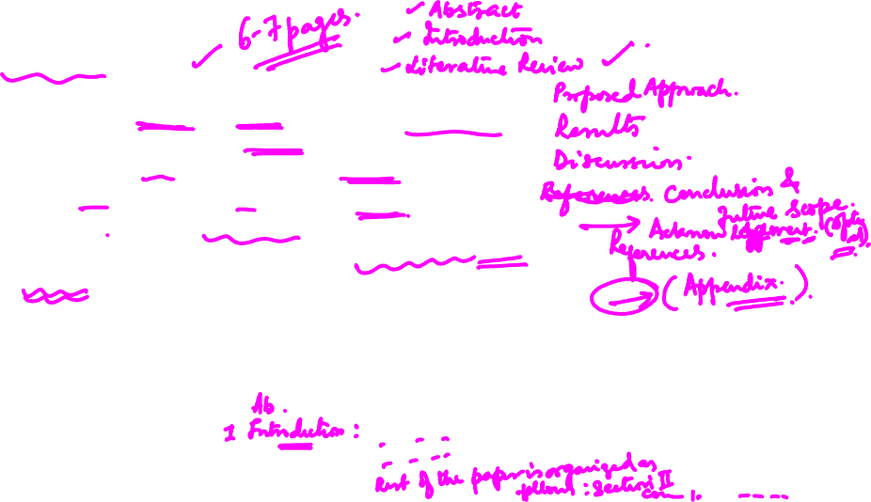
Research Methodology
Introduction
Provides background/context needed to understand the paper and appreciate its importance
Must clearly motivate, why the work is important
Identifies the question the research addressed
In general, should be fairly short
Typically should be funnel-shaped, moving from general to specific.
Key primary literature
• Hypothesis/research problem investigated
• Approaches and rationale
• Contributions

Slide 19
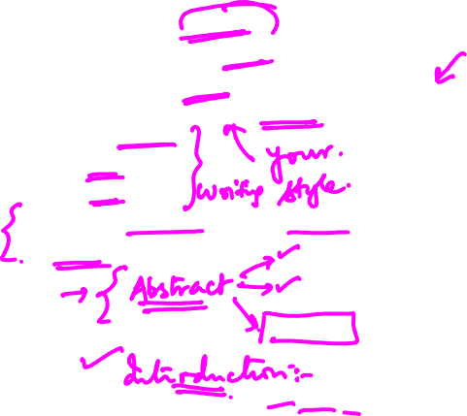
Research Methodology
Introduction
Identify the knowledge gap (research gap)
What is known -> what is unknown
Explain why it needs to be filled
Summarize how the study attempts to fill the gap.
Concise sentences
Strong verbs
Active voice
Written after the main body of the paper is completed

Slide 20

Research Methodology
Introduction- Guideline for Writing
Answer “What is the problem solved”
• Identify the knowledge gap
• Explain why it needs to be filled
• Summarize how the study fills the gap
Answer “How the problem is solved”
• Brief background/context
• Rationale/Reason for filling the gap
• Key references to very closely related work.
• Clarification of terms/definitions

Slide 21
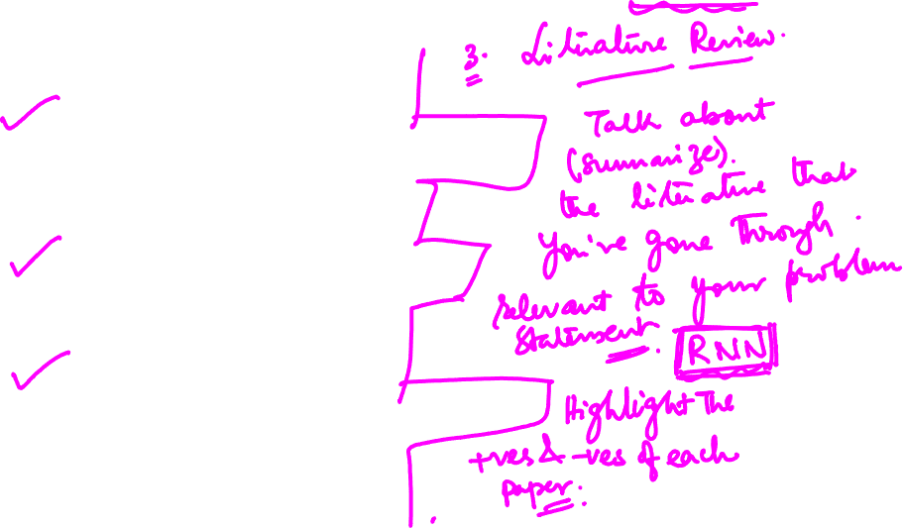
Research Methodology
Introduction- How
Step1: (Background Information)
• Strong statement that reflects your research area
• Clear aim of the study
• Don’t include obvious/broad facts
Step 2: Show the research gap
• Based on current know information/data
• What is unknown
Step 3: How the study fills the gap
• Hypothesis -> What is purposed/objective of study

Slide 22
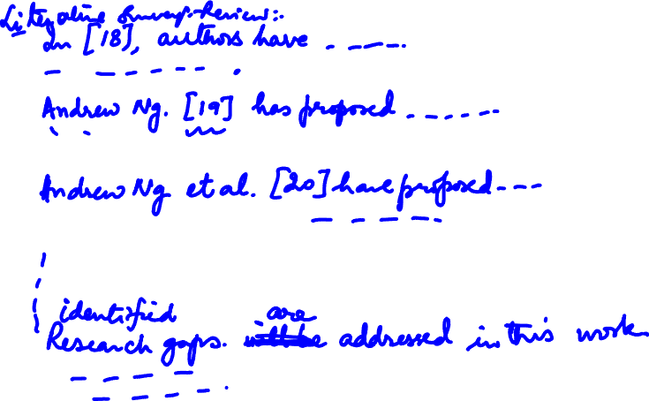

Slide 23

Research Methodology
Materials & Methods Section
Purposes: to allow others to replicate and to evaluate what you did
Should describe the study design
Should identify (if applicable)
Equipment, organisms, reagents, etc used (and sources thereof)
Approval of human or animal research by an appropriate committee
Statistical methods

Slide 24
Research Methodology
Materials & Methods Section
Introduction -> Methodology Employed (why it was chosen)
Materials and Methods Section => Experimental Procedures
The validity of the results depends on sound methodology (Good reviewer will read this section in detail)
Reproducibility of results (Sufficient Information to allow the reader to repeat)

Slide 25

Research Methodology
Materials & Methods Section
Our credibility is also at stake (poor method section)
Written in Past Tense (because its all the work that has been done, after with the report is being written)
Minimize Passive Voice (with due care)

Slide 26

Research Methodology
Methods (Contd..)
May include tables and figures
An issue: level of detail in which to describe
Well-known methods
Methods previously described but not well known
Methods that you yourself devised
Helpful to use papers published in the same journal as models

Slide 27
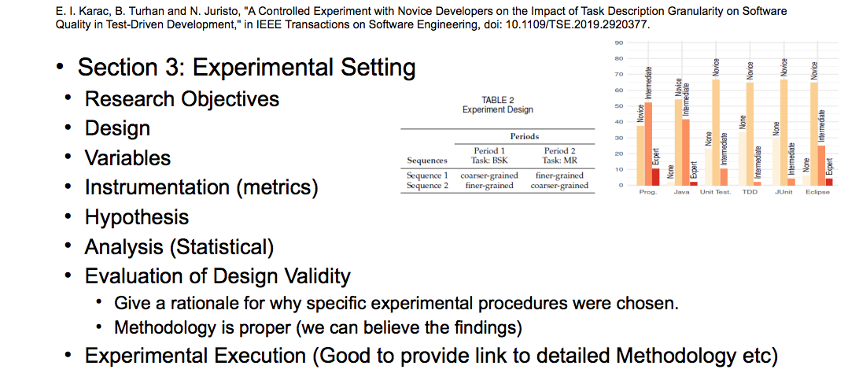
Research Methodology
Materials & Methods: Example

Slide 28
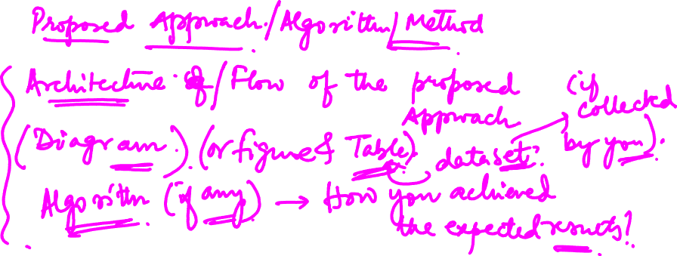

Slide 29
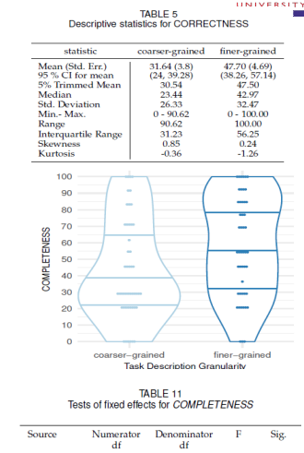
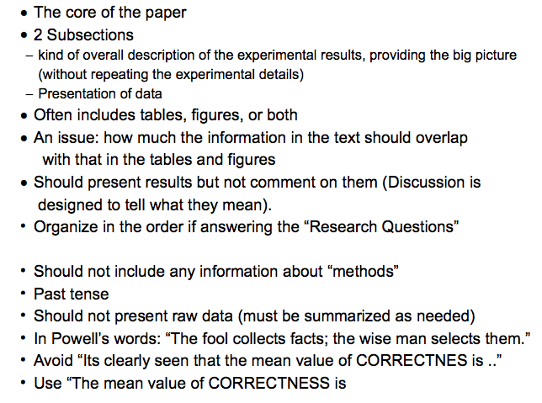

Research Methodology
Results

Slide 30
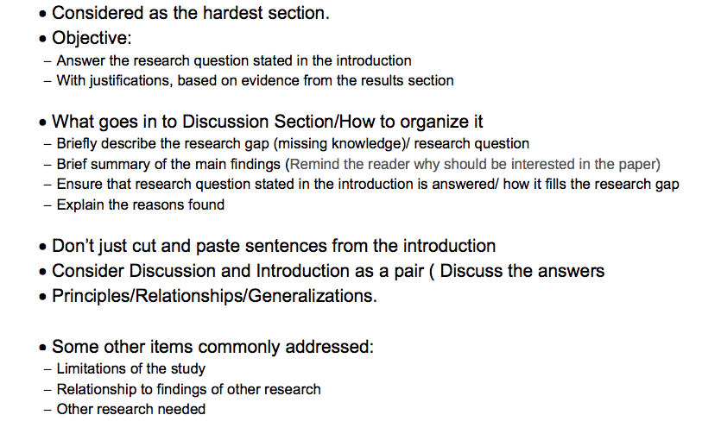
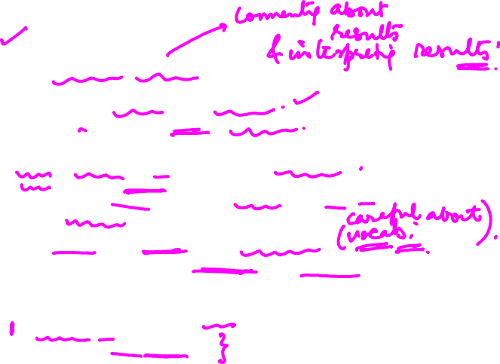
Research Methodology
Discussion

Slide 31
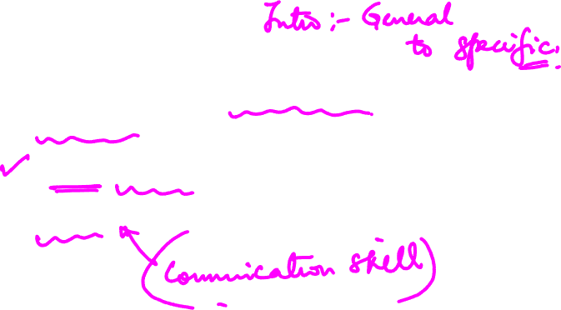
Research Methodology
Discussion (Contd..)
Typically should move from specific to general (opposite of introduction)
Significance of the paper
Active voice

Slide 32
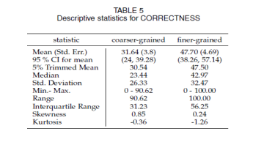

Research Methodology
Tables: A few Suggestions
Use tables only if text will not suffice.
Design tables to be understandable without the text.
If a paper includes a series of tables, use the same format for each.
Table no: Description appears above the table
Be sure to follow the instructions to authors.

Slide 33
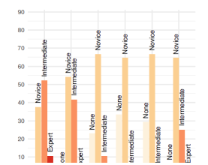

Research Methodology
Figures: A few Suggestions
Use figures (graphs, diagrams, maps, photographs, etc) only if they will help convey your information.
Avoid including too much information in one figure.
Make sure any lettering will be large enough once published.
Figure no: Description appears below the figure
Follow the journal’s instructions.

Slide 34

Research Methodology
Acknowledgements
A place to thank people who helped with the work but did not make contributions deserving authorship
Permission should be obtained from people you wish to list
Sometimes the place where sources of financial support are stated

Slide 35

Research Methodology
References/ Bibliography
Functions:
To give credit
To add credibility
To help readers find further information
Importance of accuracy
Existence of various reference formats
Availability of citation management software (examples: mendley, zotero)

Slide 36
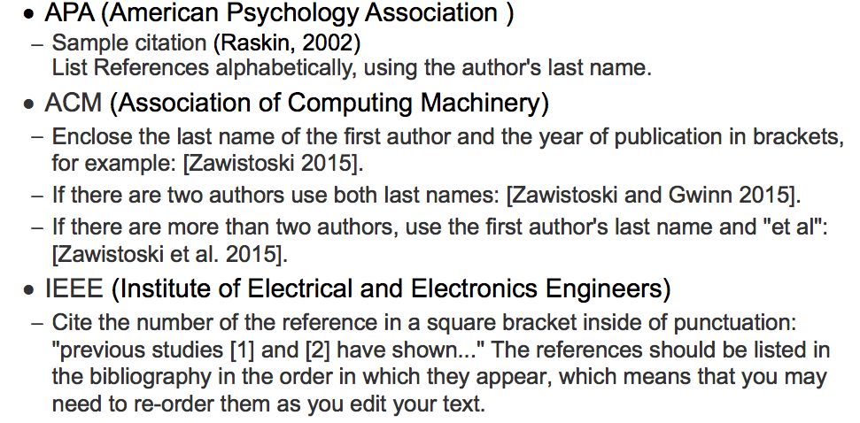
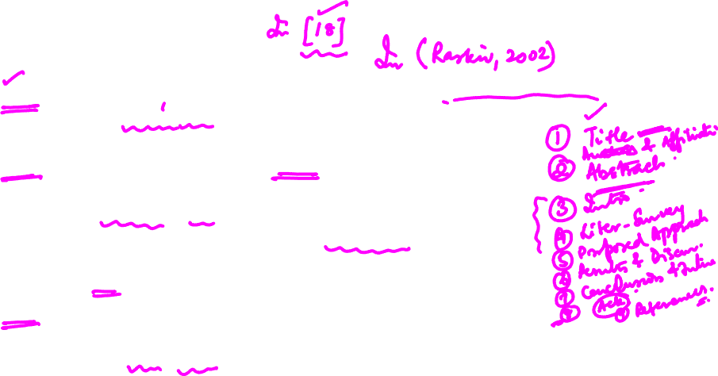
Research Methodology
References/ Bibliography Style

Slide 37
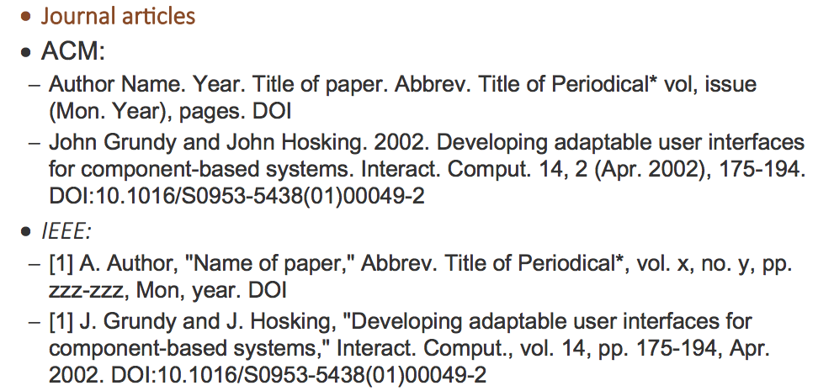
Research Methodology
References Style

Slide 38

Research Methodology
Research Impact
Every researcher’s desire: Their work should have impact (what is the effect of the work?)
How to achieve “research impact”

Slide 39
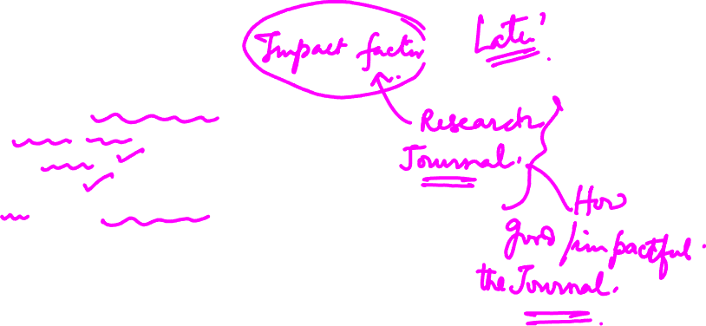
Research Methodology
Research Impact
How to measure “research impact”
Article-level metrics
Article views
Citations
Altemetric Attention Score

Slide 40
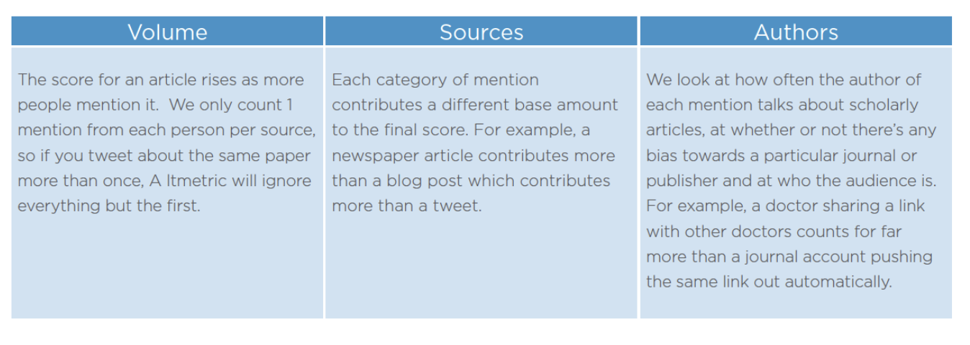

Research Methodology
Research Impact
The Altmetric Attention Score is a weighted count of the attention that a scholarly article has received. It is derived from three main factors:
https://www.altmetric.com/about-our-data/the-donut-and-score/

Slide 41
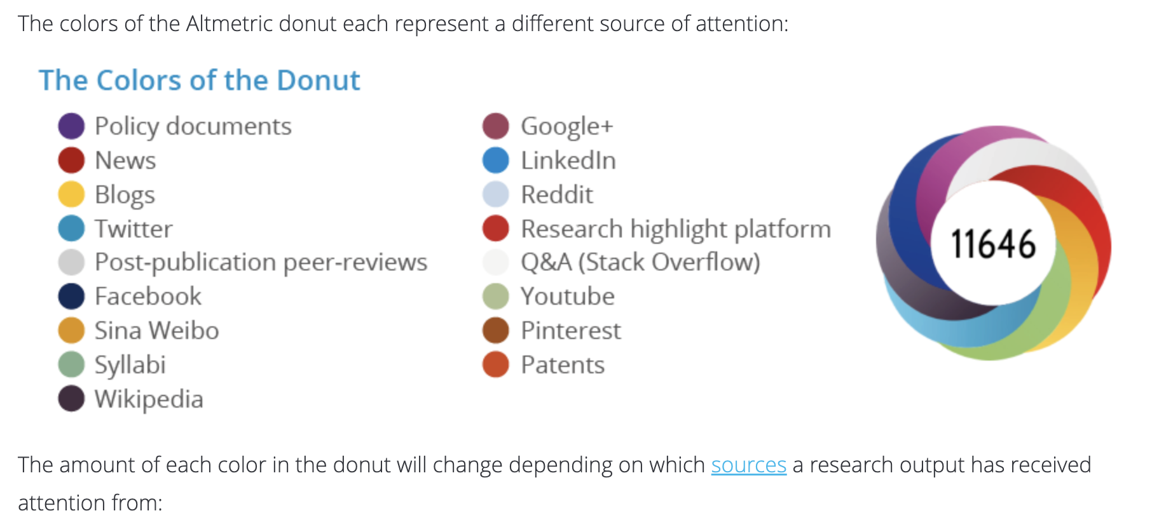

Research Methodology
Research Impact
From time to time you might notice that the Altmetric Attention Score for your paper fluctuates, or goes down.
This can happen when the original author of the mentions deletes their post.

Slide 42

Research Methodology
Journal Level metrics: Impact Factor of Journals (IF)
Definition: The journal Impact Factor is the average number of times articles from the journal published in the past two years have been cited in the Journal Citation Report (JCR) year.
The Impact Factor is calculated by dividing the number of citations in the JCR year by the total number of articles published in the two previous years.

Slide 43
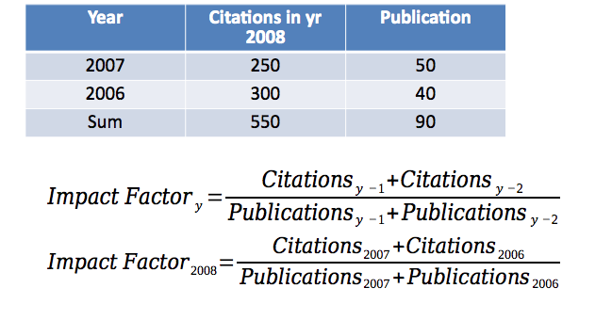
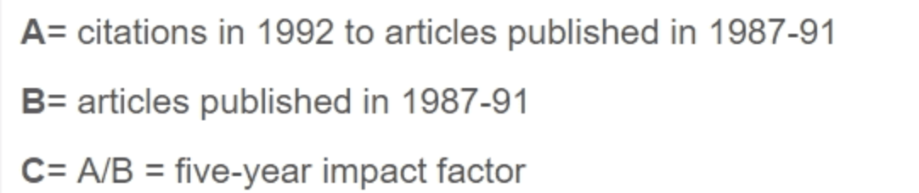
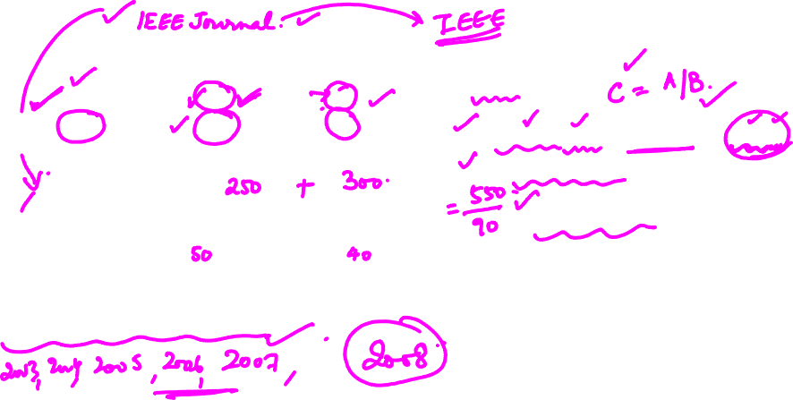
Research Methodology
Impact Factor of Journals (IF)
5-year IF

Slide 44

Research Methodology
Uses of Impact Factor of Journals (IF)
Authors to decide where to submit an article for publication.
Libraries to make collection development decisions
Academic departments to assess academic productivity
Academic departments to make decisions on promotion and tenure.

Slide 45

Research Methodology
What is DoI: Digital Object Identifier (FYI)
A digital object identifier (DOI) is a unique alphanumeric string that identifies content and provide a persistent link to its location on the Internet. ( it’s a permanent id)
The publisher assigns a DOI when the article is published and made available electronically.
DOIs also associate their publications with metadata, or relevant information related to each source (such as author, location, and date information).

Slide 46

Research Methodology
What is DoI: Digital Object Identifier (FYI)
Format: All DOI numbers begin with a 10 and contain a prefix and a suffix separated by a slash. The prefix is a unique number of four or more digits assigned to organizations( or registrant); the suffix is assigned by the publisher ( item id)and was designed to be flexible with publisher identification standards.
DOI: 10.1007/s11089-018-0833-1
Not all articles or journals use DOIs; if you can't find a DOI you can use the persistent url in your citation instead.

Slide 47
THANK YOU
Dr. Arti Arya
artiarya@pes.edu

